Slide 1


Account Management System
Hello everyone, my name is Muhammad Saeed Kamal, and today I will present our Account Management System. I will provide an overview of the system's functionality and demonstrate key principles of object-oriented programming (OOP): abstraction, encapsulation, inheritance, and polymorphism.

Slide 2
System Overview
Simulates Basic Banking Operations
Key Classes Involved
Modular Design
The system is built around several key classes, including the Program Class as the main entry point, the Account Class for managing individual accounts, the Bank Class for handling multiple accounts and transactions, and various Transaction Classes for specific operations.
The system's modular design, with distinct classes handling different responsibilities, allows for flexibility, scalability, and easier maintenance as the system grows in complexity.
The Account Management System simulates basic banking operations, allowing users to perform common transactions like deposits, withdrawals, and transfers.

Slide 3


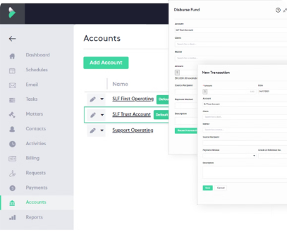


How the System Works
Initialization and User Interaction
The bank is initialized with accounts. Users are presented with a menu of options, including withdrawing, depositing, transferring money, creating a new account, and viewing transaction history.
Withdrawal Process
When a user selects the withdrawal option, they input the account name and amount. The system checks for account existence and sufficient funds, then processes the withdrawal and records the transaction.
Other Transactions
Similar processes are followed for other user actions, such as deposits, transfers, and account creation. The system ensures the integrity of the accounts and records all transactions for the user's reference.

Slide 4
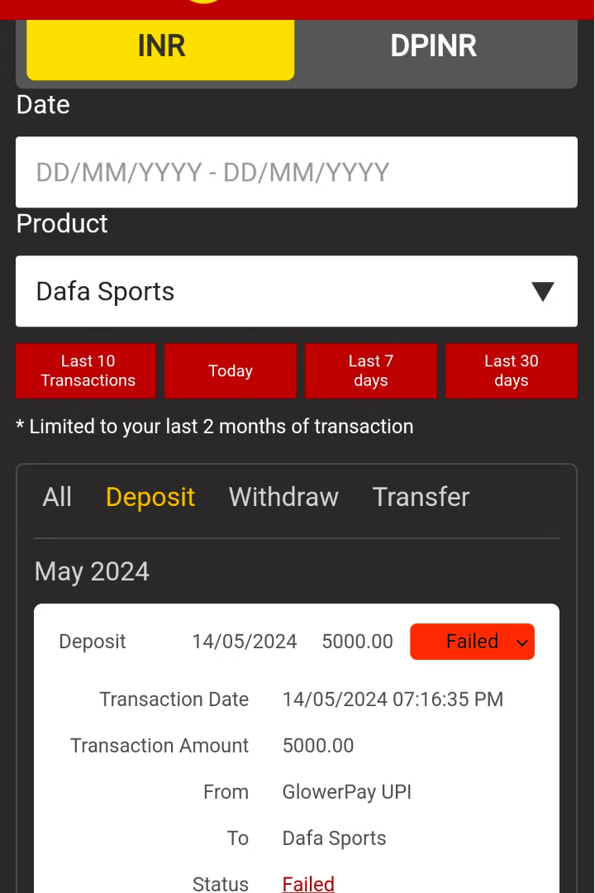
Transactions and Accounts
The system features detailed transaction types: withdrawals, deposits, and transfers.
Each transaction type has its own class, inheriting from a base Transaction class.
This setup ensures consistent execution and rollback, maintaining account data integrity.
The Account class manages the balance, ensuring consistency and security during transactions.
It validates and processes each transaction, maintaining accurate account information.

Slide 5

Abstraction
Abstraction is a key concept in object-oriented programming that hides complex details to simplify interaction.
It allows developers to focus on essential features and behaviors of an object, not the underlying implementation.
For example:
The Account class abstracts bank account operations.
The Transaction class abstracts different transaction types.

Slide 6

Encapsulation
Encapsulation is a fundamental concept in object-oriented programming that bundles data and methods together, restricting access to certain components.
It hides internal implementation details and provides a well-defined interface for interaction.
For example:
The Account class encapsulates account details and offers public methods for accessing and modifying account information.
The Transaction class encapsulates transaction logic, hiding implementation details from the rest of the system.

Slide 7
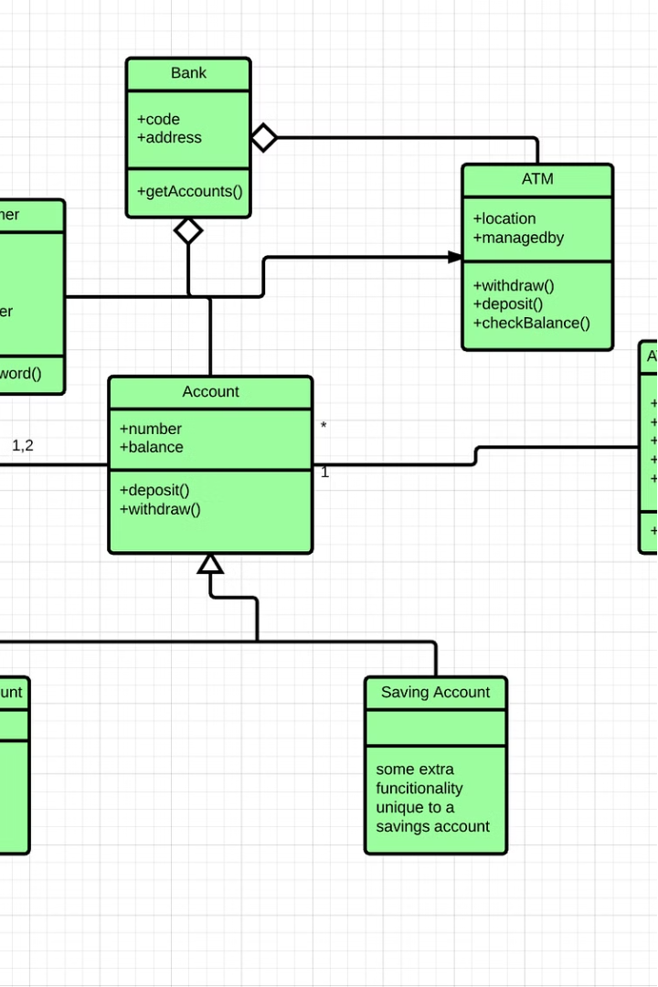
Inheritance
Inheritance is a fundamental concept in object-oriented programming that allows new classes to be created based on existing ones.
It promotes code reuse and enables the creation of hierarchical relationships between classes.
For example:
The Transaction class can serve as a base class for various types of transactions, such as deposits, withdrawals, and transfers.
Derived classes implement specific behaviors and properties for each transaction type, while inheriting common functionality from the parent class.

Slide 8

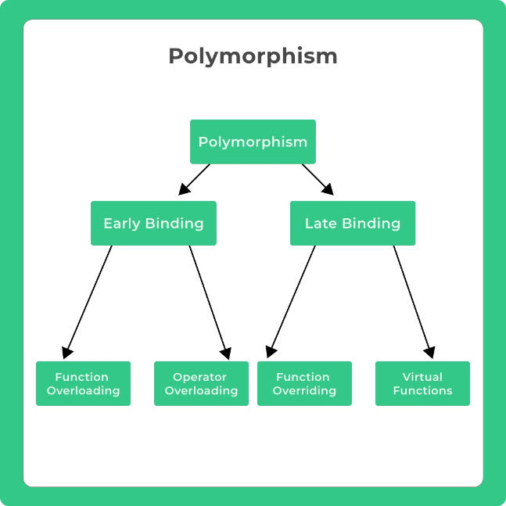
Polymorphism
Polymorphism is a fundamental concept in object-oriented programming that allows objects of different classes to be treated through the same interface.
Objects of different classes can be used interchangeably if they share a common base class or implement a common interface.
For example:
The Transaction class can define abstract methods that derived transaction types override.
This enables uniform handling of different transaction types through the Execute method.
This flexibility allows the system to handle various transaction types without complex conditional logic or explicit type checking.
Leveraging polymorphism helps maintain a clean and extensible design, making it easier to add new transaction types in the future without disrupting existing code.

Slide 9
Demonstration in Code
The implementation of object-oriented programming (OOP) principles in the code showcases abstraction, encapsulation, inheritance, and polymorphism.
The Account and Transaction classes hide system complexities, providing a clean and intuitive interface for users.
Private fields in the Account class are accessed through public methods, ensuring data integrity and security.
The Transaction class serves as a base for specific transaction types, promoting code reuse and flexibility.
Abstract methods in the Transaction class enable polymorphic behavior, allowing each transaction type to provide its unique implementation tailored to specific requirements.

Slide 10
Conclusion
Summary
The Account Management System demonstrates the principles of object-oriented programming. It is a structured, efficient, and easy-to-maintain system that helps users manage their accounts effectively.

